Slide 1

HR Analysis

Slide 2
Member1
Abdelrahman Aly
Member2
Moaz Mohamed
Member3
Mohamed Dowy
Member4
Seif Atef Taha

Slide 3








Introduction:-
The objective of the project is to analyze employee data for insights related to travel, study, review, and surveys, using Analysis Tools.

Slide 4
Project steps:-
By reading and analyzing the dataset, we extracted the key columns and understood the data extracts.
Cleaning
Design
By using Python language we did cleaning for data by identifying Missing values ​​and removing Duplicates...,etc
Understanding
Using Power BI, we designed the data by designing a number of charts to extract the main results of the HR analysis data.

Slide 5
Dataset
Employees:-
1,470 Emp
Key Columns:-
Business Travel → Employee Travel (Rarely, Frequently, Non-Travel).
Education → Educational Level (1 = Below College, 2 = College, 3 = Bachelor's, 4 = Master's,
5 = Doctor).
Age → Employee's Age.
Gender → Sex (Male, Female).
Monthly Income → Monthly Salary.
Attendance → Resignations (Yes / No).
Department → Functional Department (Sales, R&D, HR).
JobRole → Job Title.
MaritalStatus → Marital Status.
OverTime → Overtime (Yes / No).
Dataset Source:-
HR Analysis Dataset

Slide 6
Core KPIs
Total Employees
Attrition Rate
1,470 Emp
.
.
16% (237 employees out of 1,470 original)
.
.
Average Monthly Income
.
Average Age
37 Year
Total:- 6,500

Slide 7
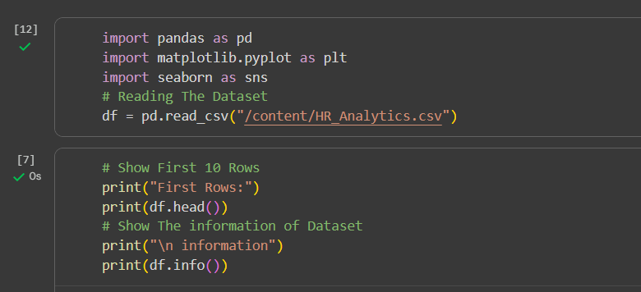
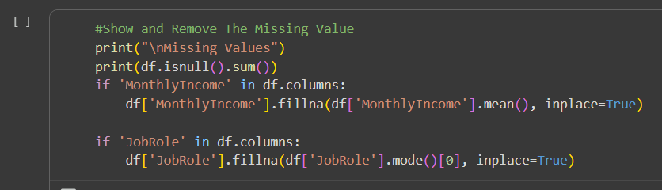
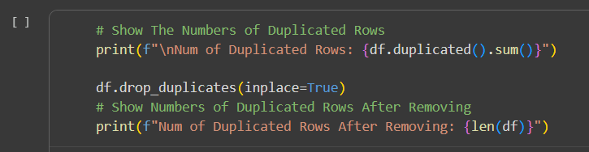
Cleaning by Python:-
.
.
.
.

Slide 8
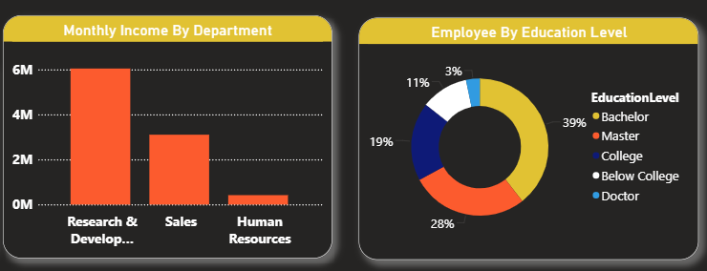
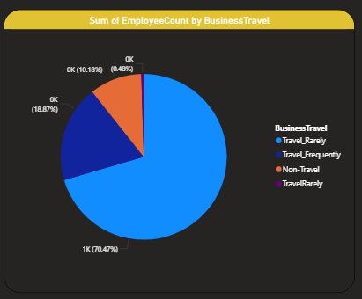
Power BI Designing:-
Continue in full Dashboard

Slide 9
Conclusion:-
The average monthly income is approximately $6,500, with significant variation across jobs.
Average Income
Attrition Rate
The total turnover rate is approximately 16% of all employees.
The highest rate is found in the sales department, followed by the advanced research (R&D) department.
Department
HR Result
Business
Travel
Most employees travel infrequently for work purposes (rarely travel ≈ 70%).
OverTime
Age Group
Overtime has a clear impact on resignations, as employees who work overtime are more likely to leave the company.
The age group between 25 and 35 is the most likely to resign.

Slide 10



Thank you for listening.
I would like to sincerely thank the National Telecommunication Institute (NTI) National Telecommunication Institute (NTI)
Alshaimaa Hussien for their valuable training and guidance, which helped us sharpen Our skills in Business Intelligence and Data Analytics.

